Slide 1

Human computer interaction and communication
MD MAMUN

Slide 2
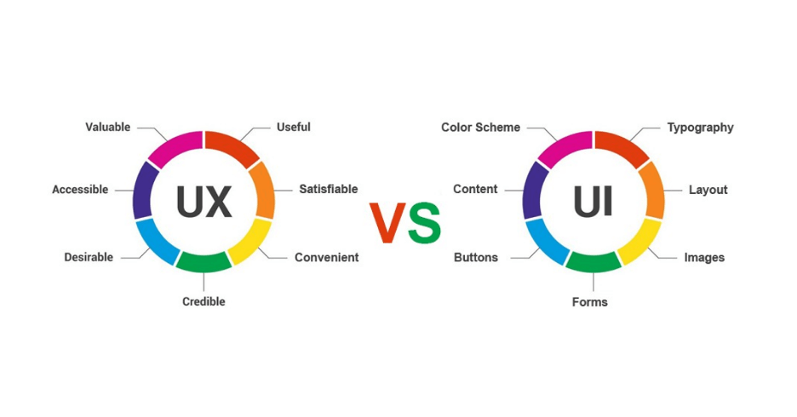
MD MAMUN

Slide 3
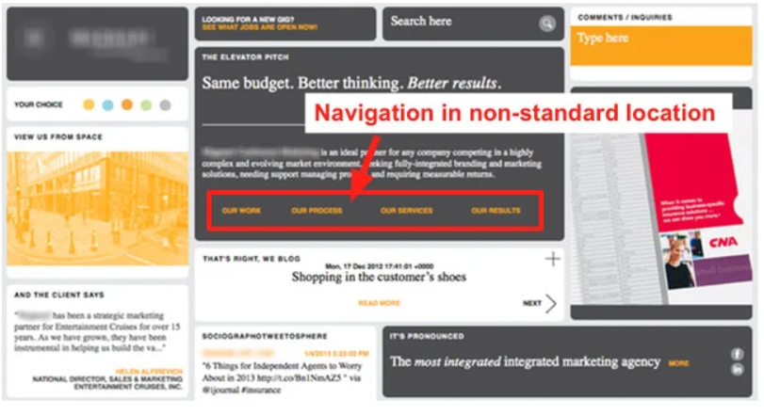
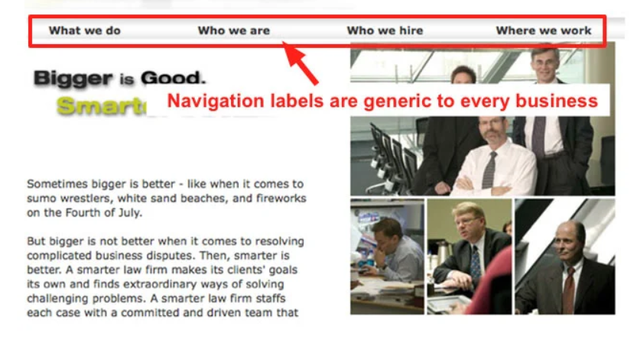
Confusing navigation

Slide 4
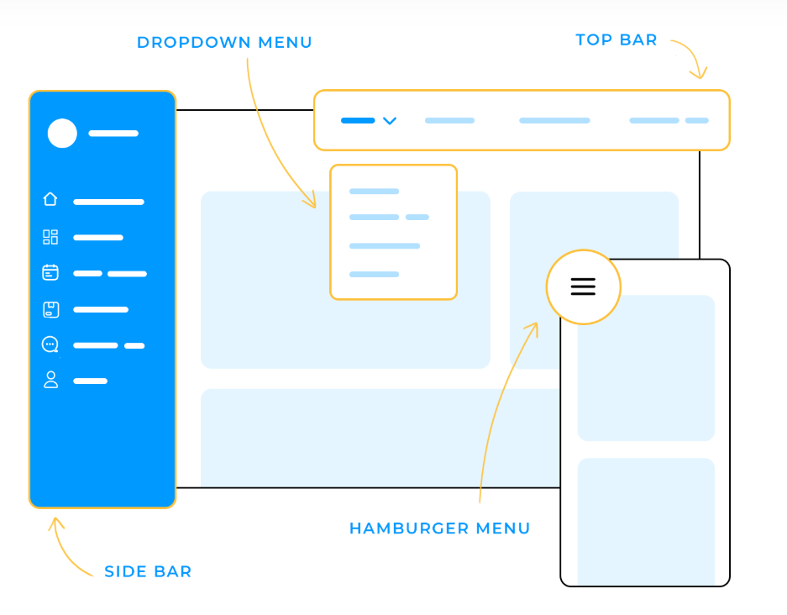
Simple and clear navigation

Slide 5
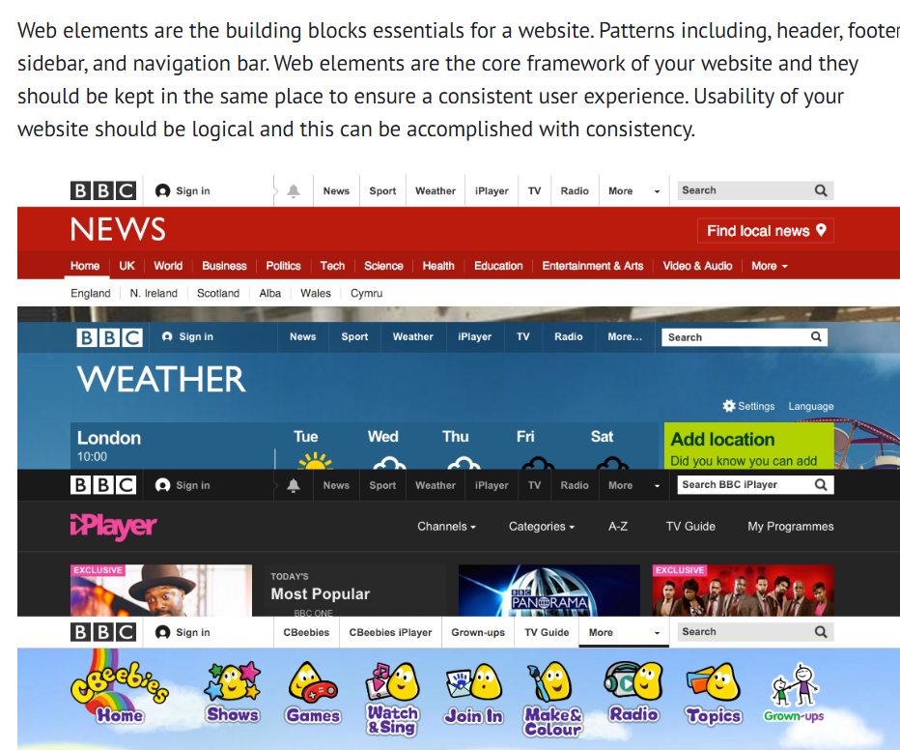
Inconsistent design – Rendom color, fonts, and layouts

Slide 6
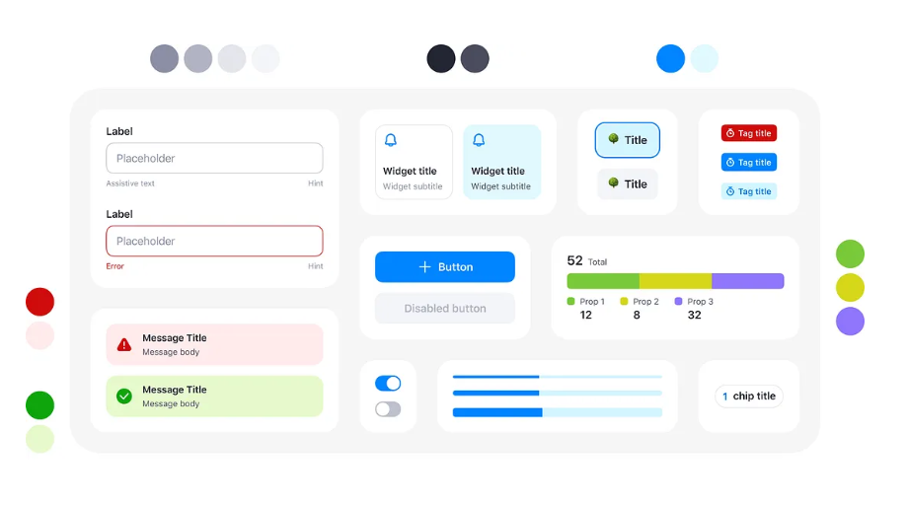
Consistency – color

Slide 7
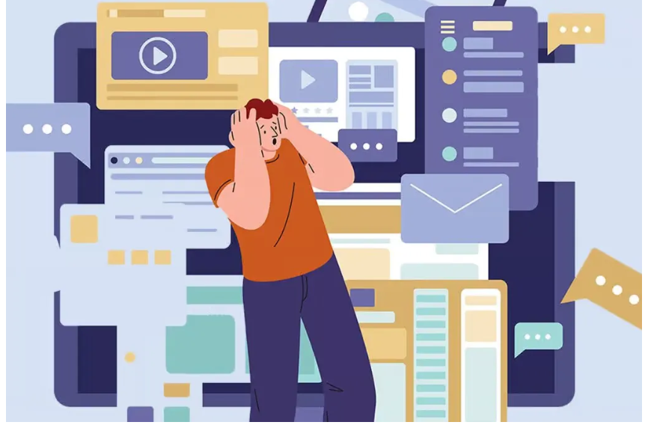
Taking too many time

Slide 8
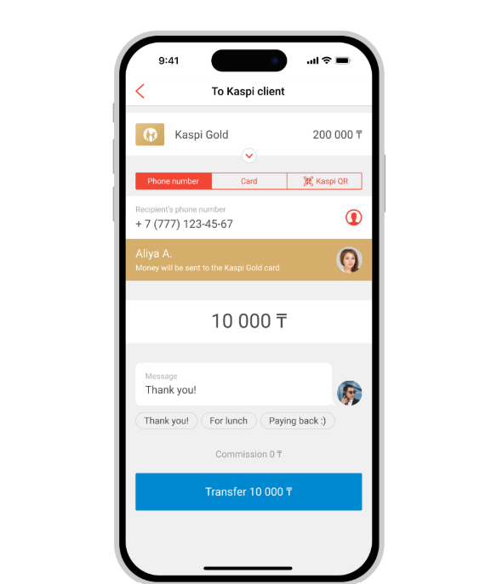

Slide 9
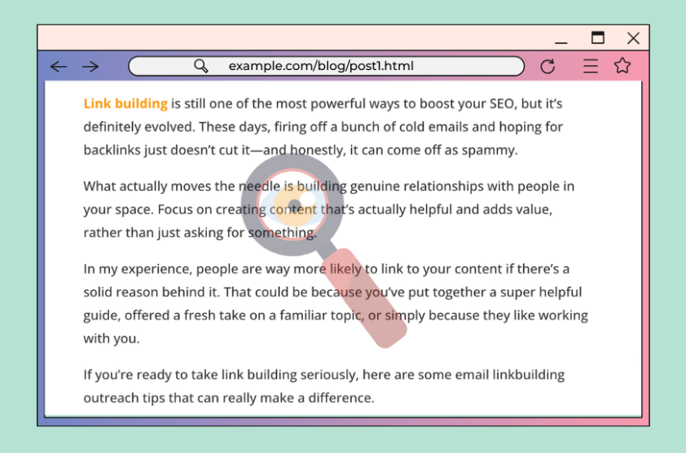
Hidden but Importend

Slide 10
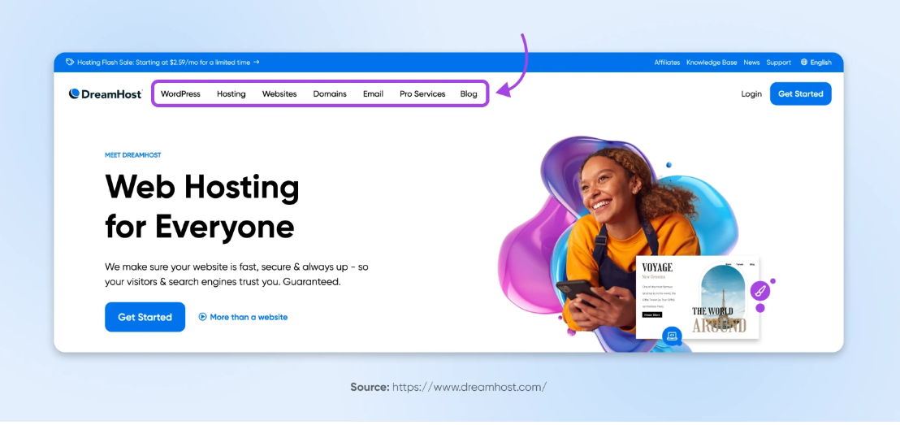

Slide 11
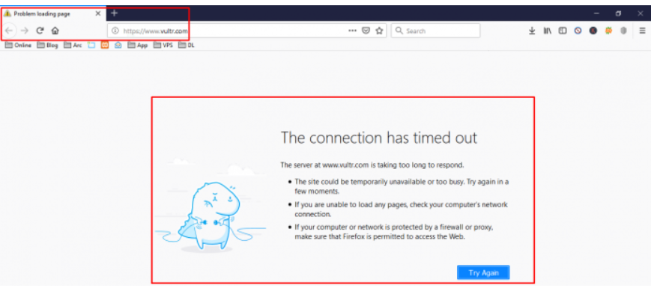
Slow performance

Slide 12
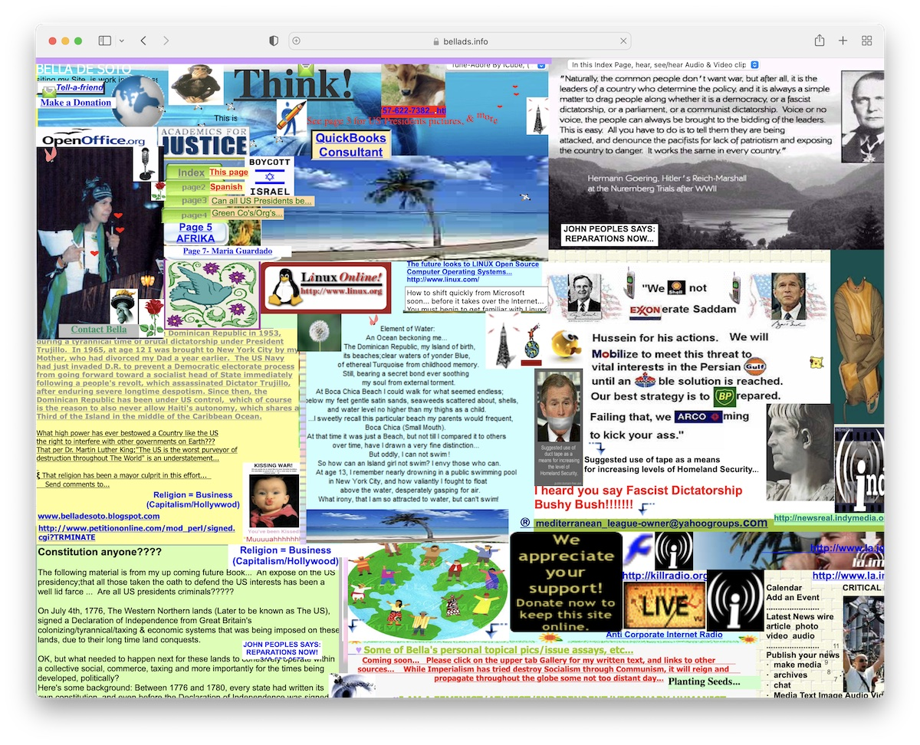
Cluttered Screen

Slide 13
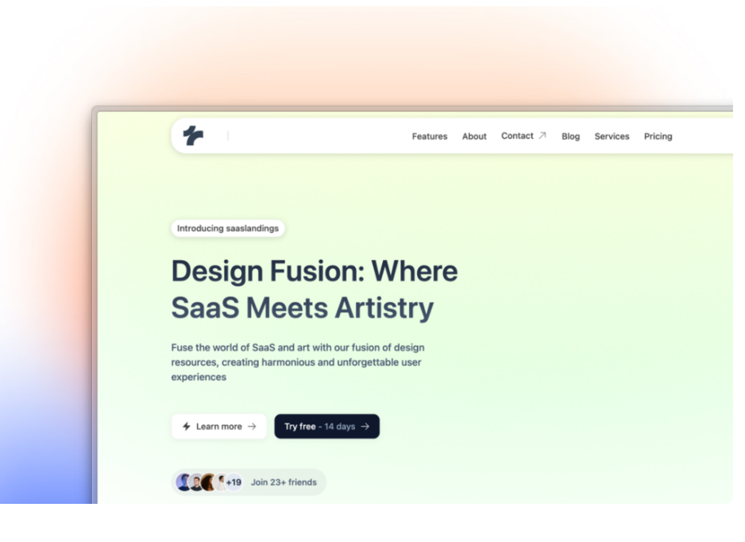

Slide 14
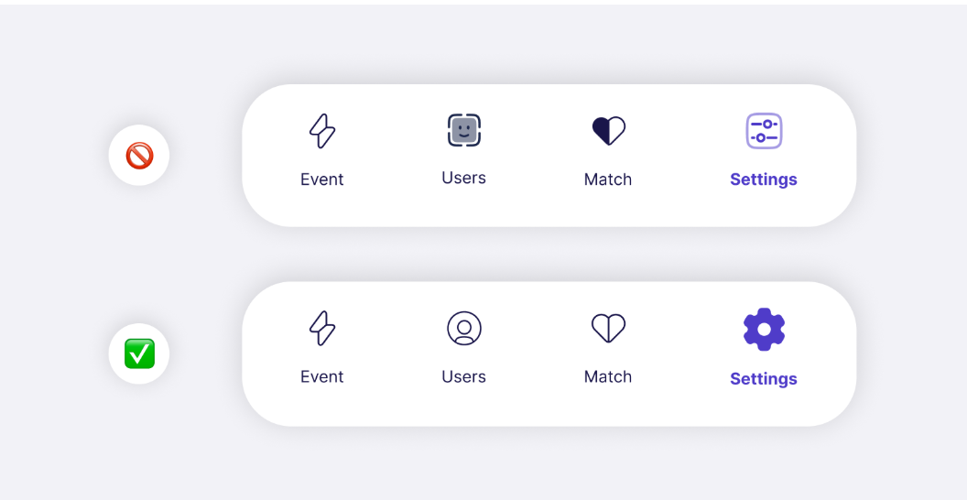
Unclear icons

Slide 15
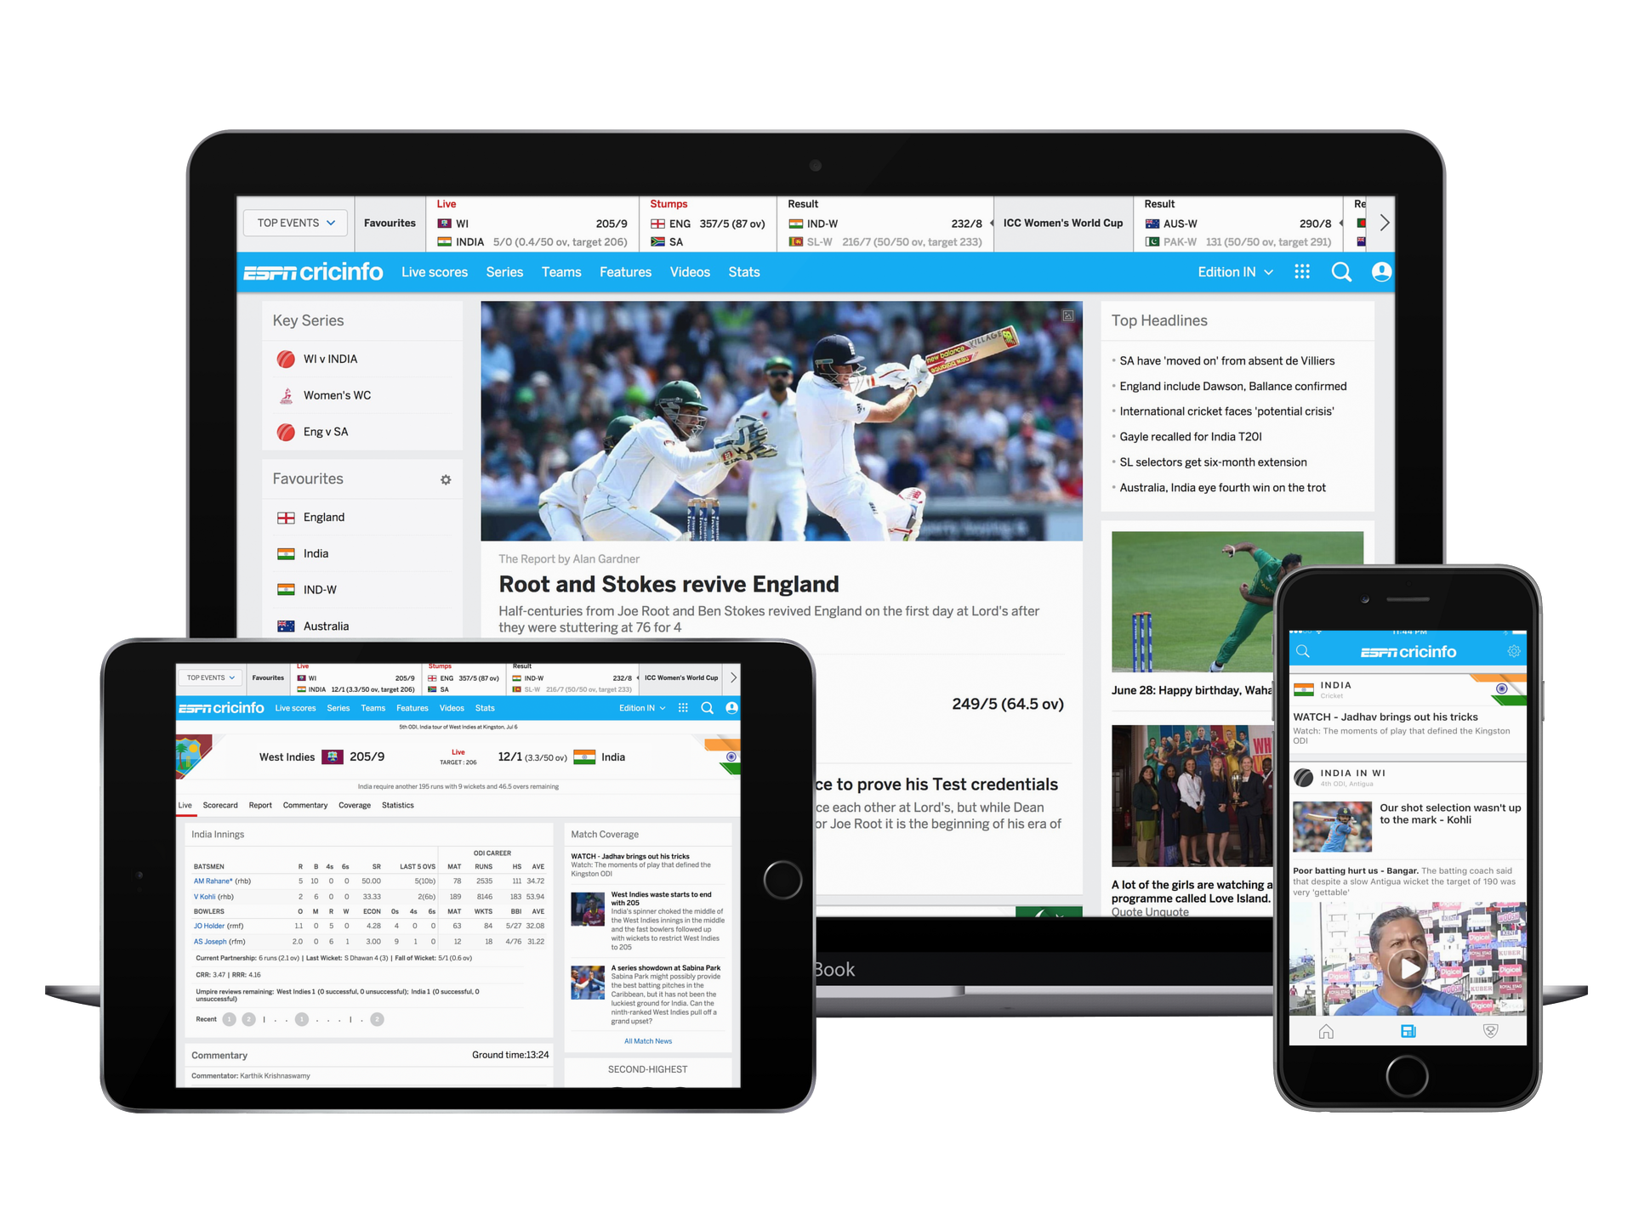
Responsive
Looks good on phone, tablet, and computer

Slide 16
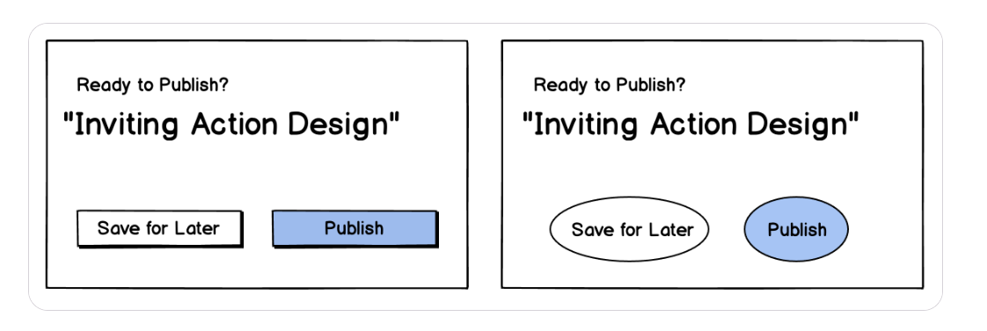
Button

Slide 17

Don’t make me think.

